Slide 1
Mobile Computing
Learning Unit 3 Android fundamentals
Moaath Alrajab

Slide 2
Objectives:
Take a deeper look at Hello World App
Change app name and add more controls
Understand resources and the manifest file
Enable an event and add a Toast
Discuss Android fundamental building blocks and components
Understand the Activity lifecycle
Discuss MVC and Android Resources

Slide 3
Fundamentals of Android Application
The very basic four fundamental building blocks from which all Android applications are built are:
Activities
Services
Broadcast Receivers
Content providers
Others such as Intent, Resource Externalization, and Notifications
The focus in this learning unit is Activity and Resources.
Notes:
In Android Studio there are short cuts to these locations

Slide 4
Activities
Activity class is designed to present a GUI.
This class supports a single focused screen that the user can use such as dialing a phone number or entering contact information and so on.
Activities are public classes, inheriting from the android.app.Activity base class
This class will be discussed further. But first let’s check the lifecycle of an activity.
Notes:
In Android Studio there are short cuts to these locations

Slide 5
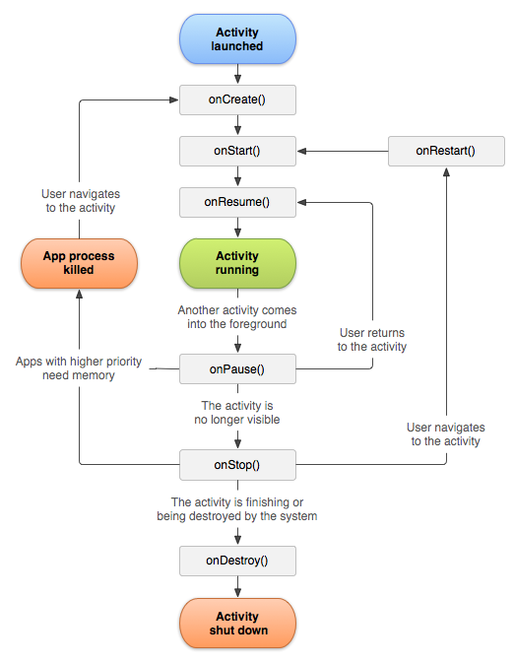
Activity Lifecycle

Slide 6
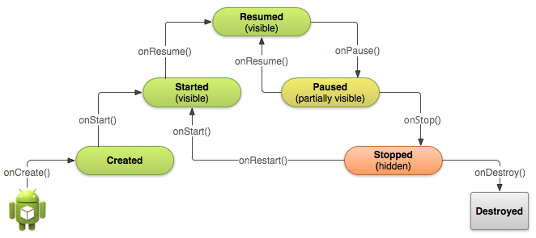
Activity Lifecycle – cont.
onCreate – called when first created (and when portrait/landscape changes)
onStart – called just before activity becomes visible on screen
onResume – whenever activity comes to the foreground
onPause – when activity is stopped and no longer visible, used to suspend resource intensive actions
onStop – when activity is no longer visible or is being destroyed
onDestroy – when activity is completed and is going to be destroyed

Slide 7
Service
Runs in the background
Perform long running operations
Support interaction with remote processes.
Example: backup application, running a music track and so on.

Slide 8
Broadcast Receivers
Broadcast receiver's listen for and respond to events.
This class plays the role of the subscriber in the publish/subscribe pattern.
In Android, events are represented by the intent class.
Publishers create these intents and then broadcast them using a method like sendBroadcast(Intent, String).
Now, once broadcasted, these intents are then routed to the broadcast
receivers that have subscribed to, or registered for, those specific intents. At which point, they can respond to the event.

Slide 9
Content Providers
Store and share data across applications
Handle requests
Keep tracks of data
Example: the browser application uses the contentprovider class.

Slide 10
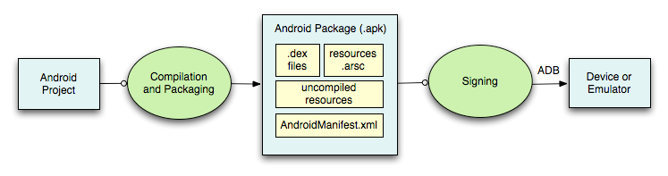
Building Android Application
The Android build process provides project and module build settings so that your Android modules are compiled and packaged into .apk files. The apk file for each app contains all of the information necessary to run your application on a device or emulator, such as compiled .dex files (.class files converted to Dalvik byte code), a binary version of the AndroidManifest.xml file, compiled resources (resources.arsc) and un-compiled resource files for your application.
http://developer.android.com/tools/building/index.html

Slide 11
Android PacKage (APK)
Each project should be packaged as .apk to run.
Use Gradle to compile, build and create apps
Every application must have an AndroidManifest.xml file (with precisely that name) in its root director which:
names the Java package for the application.
describes the components of the application
also declares all permissions
declares the minimum level of the Android API that the application requires.
lists the libraries that the application must be linked against.
http://developer.android.com/guide/topics/manifest/manifest-intro.html

Slide 12
Android PacKage (APK) cont.
Each Android App is secured by the following features:
Android OS which is a multi-user Linux system and each app is a unique user.
Each app is assigned a unique Linux user ID with its assigned permission (files…)
Each app has a its own copy of the virtual machine that runs the dex files.
Every app has its own thread. The android system starts the process when an app is executed.
Android is an OS that implement the principle of least privilege (each app access its components and what else permitted).
http://developer.android.com/guide/topics/manifest/manifest-intro.html

Slide 13
Creating Android App process
Defining resources
Implementing classes
Packaging application
Deploying the app.
A well planned app should define resources such as images, media, layouts and so on. This allows modifying application without recoding. One important resource is the String class.

Slide 14
Device Compatibility
Android is designed to run on many different types of devices, from phones to tablets and televisions. The range of devices provides a huge potential audience for your app. In order for your app to be successful on all these devices, it should tolerate some feature variability and provide a flexible user interface that adapts to different screen configurations.
There are two types of compatibility:
device compatibility and
app compatibility.

Slide 15
Device Compatible
Android is an open source project, any hardware manufacturer can build a device that runs the Android operating system. Yet, a device is "Android compatible" only if it can correctly run apps written for the Android execution environment.
Google Play Store has only the compatible devices.

Slide 16
App Compatible
Android supports a variety of features your app can leverage through platform APIs. Some features are hardware-based (such as a compass sensor), some are software-based (such as app widgets), and some are dependent on the platform version. Such as screen resolution, features and platform compatibility.
// For feature compatibility
// For platform compatibility
<manifest ... >
<uses-feature android:name="android.hardware.sensor.compass"
android:required="true" />
...
</manifest>
<manifest ... >
<uses-sdk android:minSdkVersion="14" android:targetSdkVersion="19" />
...
</manifest>

Slide 17
Manifest File
Name space
Package
versionCode/versionName
<uses-sdk>
minSdkVersion
targetSdkVersion
maxSdkVersion (optional)
<application> - identifies important items for the application
<activity> - identifies activities and their properties
Other commonly used tags: <service>, <receiver>, <provider>, <uses-permission>

Slide 18
Manifest File – You need to visit the link below for more info
<?xml version="1.0" encoding="utf-8"?>
<manifest xmlns:android="http://schemas.android.com/apk/res/android"
package="com.example.defaultexample"
android:versionCode="1"
android:versionName="1.0" >
<uses-sdk
android:minSdkVersion="8"
android:targetSdkVersion="17" />
<application
android:allowBackup="true"
android:icon="@drawable/ic_launcher"
android:label="@string/app_name"
android:theme="@style/AppTheme" >
<activity
android:name="com.example.defaultexample.MainActivity"
android:label="@string/app_name" >
<intent-filter>
<action android:name="android.intent.action.MAIN" />
<category android:name="android.intent.category.LAUNCHER" />
</intent-filter>
</activity>
</application>
</manifest>
http://developer.android.com/guide/topics/manifest/manifest-intro.html

Slide 19

MVC and Android
What is MVC:
It is apparent that the user interface logic tends to change more often than the business logic, the mobile, desktop, and Web developers needed a much easier way of separating UI from actual code (the brain). This separation is called MVC.
Model — the data layer, responsible for managing the business logic and handling network or database API.
In simple words, what to show
View — the UI layer — a visualization of the data from the Model.
In simple words, How to show
Controller — the logic layer, gets notified of the user’s behavior and updates the Model as needed.
In simple words, compute, events, validate and so on

Slide 20
MVC and Android cont.
MVC is a concept rather than a programming language or framework. The way you implement varies.
How Should MVC Be Applied in Android
The Activities, Fragments and Views should be the Views in the MVC world. (derived from android.view.View so they are different in Android from iOS and so on)
The Controllers should be separate classes that don’t extend or use any Android class (controllers should be platform/app independents),
and same for the Models. Models should be platform independents.

Slide 21
Resources – definition
Resources are the data that your application uses:
- Maintain them independently:
Resources such as images and strings should be separated from your application code, so that you can maintain them independently.
- Widen device support:
Externalizing your resources also allows you to provide alternative resources that support specific device configurations such as different languages or screen sizes, which becomes increasingly important as more Android-powered devices become available with different configurations

Slide 22
Resources – by nature
Default resources
are those that should be used regardless of the device configuration or when there are no alternative resources that match the current configuration.
Alternative resources
are those that you've designed for use with a specific configuration. To specify that a group of resources are for a specific configuration, append an appropriate configuration qualifier to the directory name.

Slide 23
Resources types
In android project, data are provided in your resources directory (res/)
Here's a brief summary of each resource type:
Animation Resources
Define pre-determined animations.
Tween animations are saved in res/anim/ and accessed from the R.anim class.
Frame animations are saved in res/drawable/ and accessed from the R.drawable class.
Color State List Resource
Define a color resources that changes based on the View state.
Saved in res/color/ and accessed from the R.color class. Drawable Resources
Define various graphics with bitmaps or XML.
Saved in res/drawable/ and accessed from the R.drawable class.
Layout Resource
Define the layout for your application UI.
Saved in res/layout/ and accessed from the R.layout class.

Slide 24
Resources types - cont.
In android project, data are provided in your resources directory (res/)
Here's a brief summary of each resource type:
Menu Resource
Define the contents of your application menus.
Saved in res/menu/ and accessed from the R.menu class.
String Resources
Define strings, string arrays, and plurals (and include string formatting and styling).
Saved in res/values/ and accessed from the R.string, R.array, and R.plurals classes.
Style Resource
Define the look and format for UI elements.
Saved in res/values/ and accessed from the R.style class.
More Resource Types
Define values such as booleans, integers, dimensions, colors, and other arrays.
Saved in res/values/ but each accessed from unique R sub-classes (such as R.bool, R.integer, R.dimen, etc.).

Slide 25
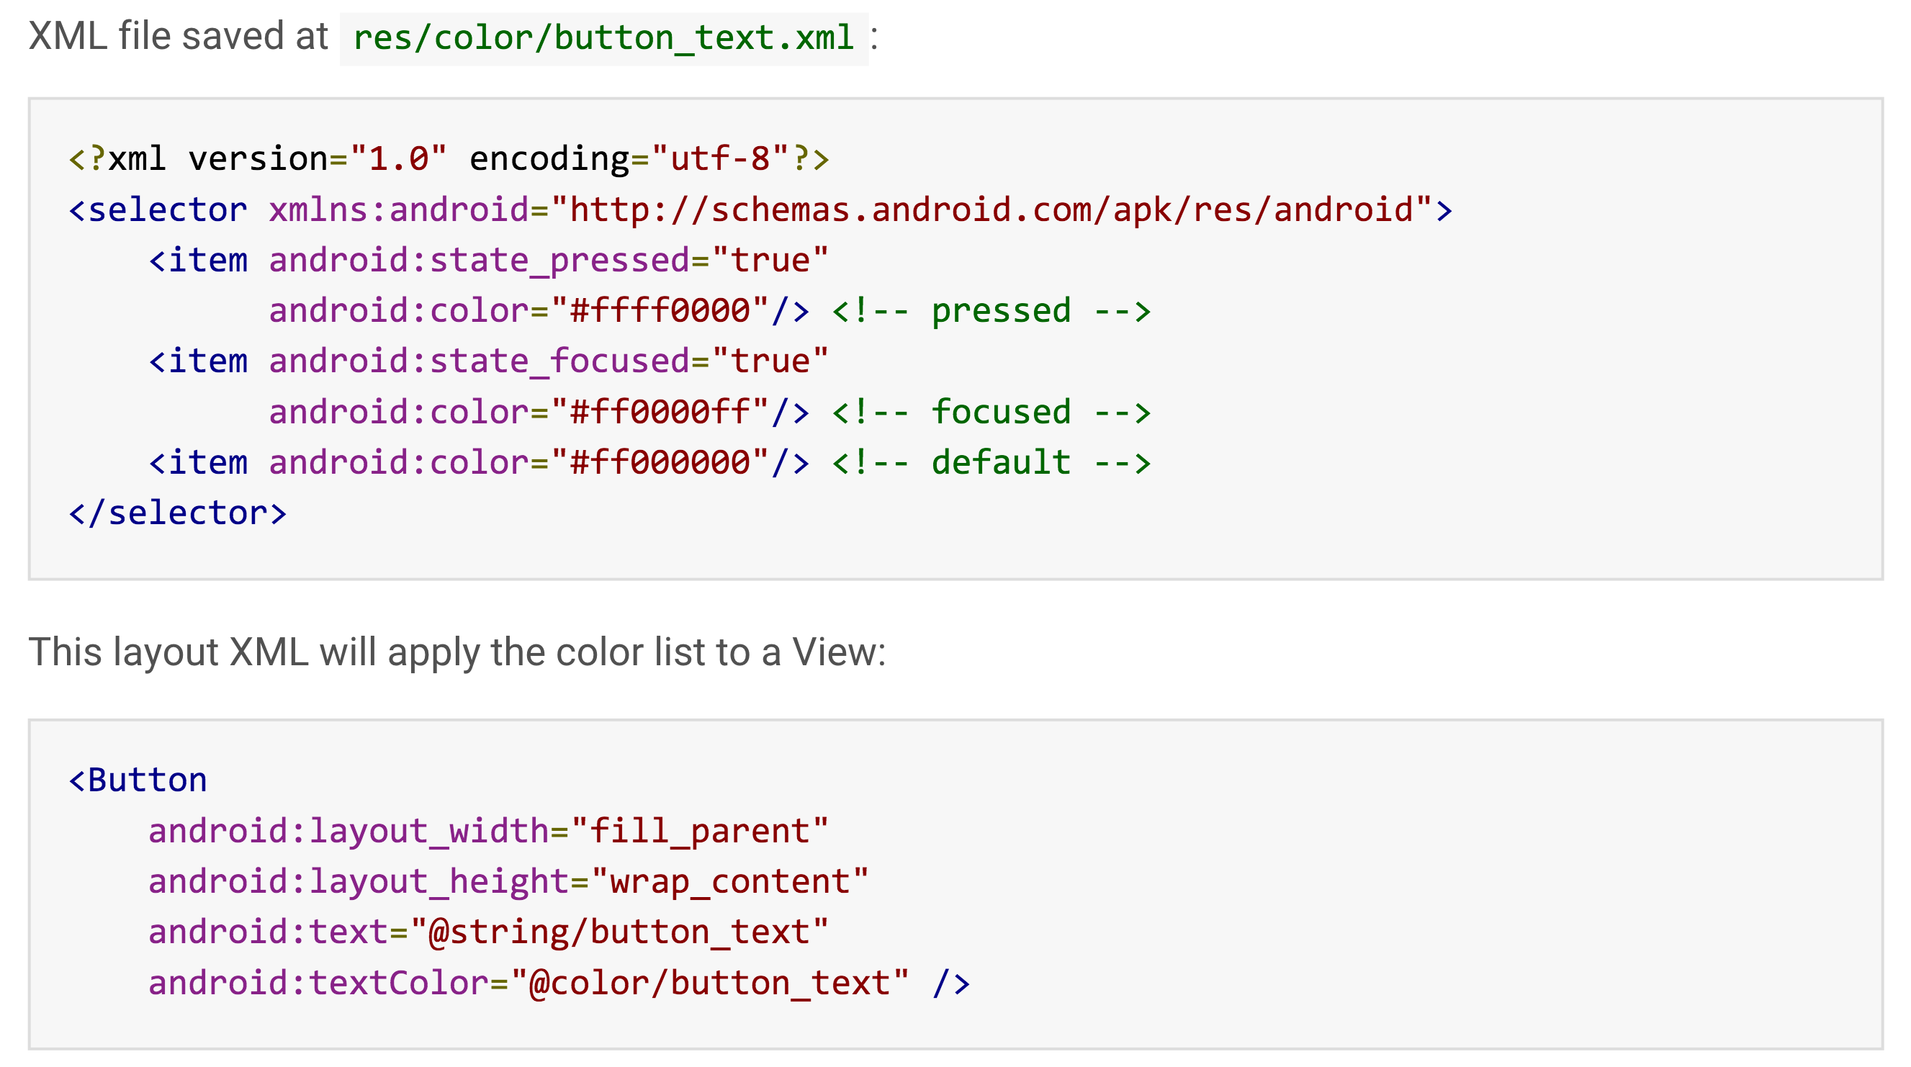
Example of color state
Each color is defined in an <item> element inside a single <selector> element. Each <item> uses various attributes to describe the state in which it should be used. During each state change, the state list is traversed top to bottom and the first item that matches the current state will be used.

Slide 26
Resources: String
There available types:
String
String-array
Plural
String can be accessed via the xml file stored in the res folder under android project.
In xml you write: <string name=“dept”>Computer Sci</string> now the string ‘dept’ can have deffirent values such as Computer Sci, or other values.
For example: if you want to add a new language to the app then add to resources directory a file with a new language strings like values-fr. Then the previous string can be displayed as ‘l'informatique’
You can access values from Java using R.string…

Slide 27
Creating Value Resources
Example strings.xml
Reference in XML
@string/app_name
Get string in code
getString(R.string.app_name)
<resources>
<string name="app_name">My University name</string>
<string name="hello_world">Hello world!</string>
<string name="menu_settings">Settings</string>
<string name="title_activity_screen_orientation_app">
Screen Orientation App </string>
</resources>

Slide 28
Creating Dimension Resources
Example dimens.xml
Reference in XML
@dimen/small_size
Get dimension in Java code
getResources().getDimension(R.dimen.small_size)
<?xml version="1.0" encoding="utf-8"?>
<resources>
<dimen name="small_size">15dp</dimen>
<dimen name="medium_size">15sp</dimen>
<dimen name="large_size">20pt</dimen>
</resources>
dp - Density-independent pixel (dp)
dpi - (dots per inch)
px = dp * (dpi / 160) - 160 is the baseline density
sp - scale-independent pixels
pt - point 1/72 of an inch based on the physical screen

Slide 29
Creating Color Resources
Color formats
#RGB, #RRGGBB, #ARGB, #AARRGGBB
Example colors.xml
Reference in XML
@color/red_color
Get color in Kotlin code
resources.getColor (R.color.red_color)
<?xml version="1.0" encoding="utf-8"?>
<resources>
<color name="red_color">#F00</color>
<color name="green_color">#00FF00</color>
<color name="blue_alpha_color">#500000FF</color>
</resources>

Slide 30
Creating Style Resources
Example styles.xml
<resources>
<style name="AppTheme" parent="android:Theme.Light" />
<style name="style1">
<item name="android:textColor">#00FF00 </item>
<item name="android:typeface">serif</item>
<item name="android:textSize">30sp </item>
</style>
<style name="style2" parent="style1" >
<item name="android:textColor">#0000FF</item>
<item name="android:typeface">sans</item>
<item name="android:background">#FF0000</item>
<item name="android:padding">10dip</item>
</style>
<style name="style3" parent="style2" >
<item name="android:textColor">#00FF00</item>
<item name="android:background">#00000000</item>
<item name="android:typeface">monospace</item>
<item name="android:gravity">center</item>
</style>
</resources>

Slide 31
Creating Style Resources – cont.
Add to a view in XML
style=“@style/style1”
Add to activity in Android manifest
android:theme=“@style/AppTheme”

Slide 32
Arrays (Strings)
A collection of values or elements
Example strings.xml
<resources>
<string name="app_name">StringArrayApp</string>
<string name="menu_settings">Settings</string>
<string name="title_activity_string_array_app">StringArrayAppActivity</string>
<string-array name=“Fruits">
<item>Apple</item>
<item>Mango</item>
<item>Orange</item>
<item>Grapes</item>
<item>Banana</item>
</string-array>
</resources>

Slide 33
Arrays (Strings) – Demo Example
package com.androidunleashed.stringarrayapp;
class MainActivity : AppCompatActivity() {
override fun onCreate(savedInstanceState: Bundle?) {
super.onCreate(savedInstanceState);
setContentView(R.layout.activity_string_array_app);
val fruitsView = findViewById<View>(R.id.fruits_view) as TextView val fruitsArray = resources.getStringArray(R.array.Fruits) var str = "" for (i in fruitsArray.indices) { str += """ ${fruitsArray[i]} """.trimIndent() } fruitsView.text = str
}
}

Slide 34
Arrays (Strings) – cont.
Activity_string_array_app.xml
<LinearLayout
xmlns:android="http://schemas.android.com/apk/res/android"
xmlns:tools="http://schemas.android.com/tools"
android:orientation="vertical"
android:layout_width="match_parent"
android:layout_height="match_parent" >
<TextView
android:id="@+id/fruits_view"
android:layout_width="match_parent"
android:layout_height="wrap_content" />
</LinearLayout>

Slide 35
Drawable Resources
A drawable resource is a general concept for a graphic that can be drawn to the screen and which you can retrieve with APIs such as getDrawable(int) or apply to another XML resource with attributes such as android:drawable and android:icon.
PNG, JPG, and GIF
320dpi, 240dpi, 160dpi, 120dpi (dots per inch)
drawable-xhdpi, -hdpi, -mdpi, -ldpi
How to use:
@drawable/image_filename
R.drawable.image_filename
http://developer.android.com/guide/topics/resources/drawable-resource.html

Slide 36
Drawable Resources – cont.
Shape Drawable
Imagine that you want to include a gradient background color for a TextView of a layout. The answer in the next example:
This is a generic shape defined in XML.
FILE LOCATION:
res/drawable/filename.xml
RESOURCE REFERENCE:
In Kotlin: R.drawable.filename
In XML: @[package:]drawable/filename

Slide 37
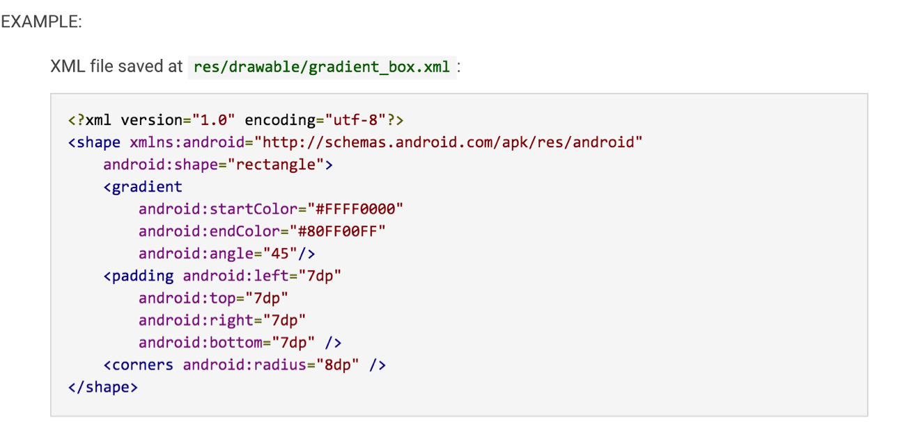
Drawable Resources – example 1/2

Slide 38
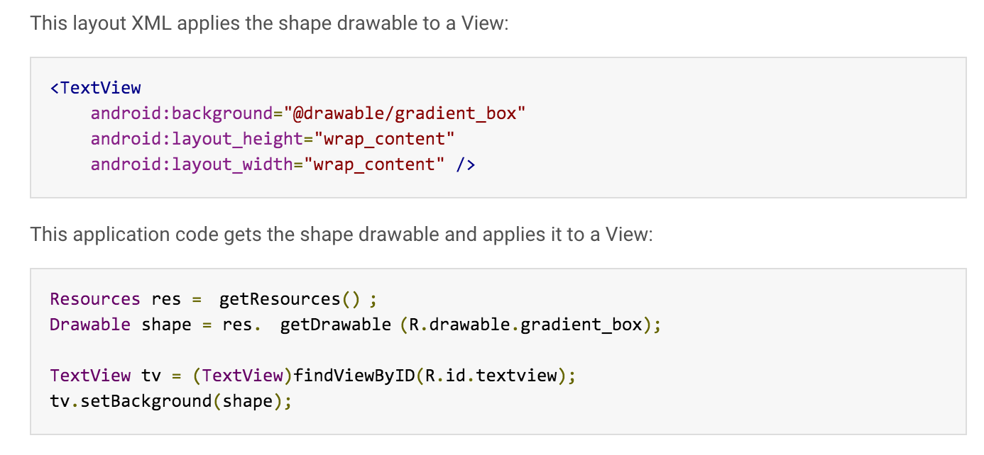
Drawable Resources – example2/2

Slide 39
Android App structure
A layout defines the visual structure for a user interface.
Using Android's XML vocabulary, you can quickly design UI layouts and the screen elements they contain, in the same way you create web pages in HTML — with a series of nested elements.
The advantage to declaring your UI in XML is that it enables you to better separate the presentation of your application from the code that controls its behavior.
Layouts host Android apps’ components. What are Android UI components?

Slide 40
Basic UI Components/controls
TextView – a read-only text label
EditText – an editable text box
ListView – a ViewGroup that creates and manages a vertical list of views
Spinner – a TextView and an associated list of items to allow you to select an item from the list
Button – a standard command button
CheckBox – a button allowing a user to select/check or unselect/uncheck
RadioButton – a mutually exclusive button selecting an item from a group

Slide 41
EditText
layout_height – e.g. wrap_content, match_parent
singleLine – true, remains on single line; false, doesn’t
hint – background hint
lines – number of lines
textSize – size of text
autoText – auto correct text
capitalize – auto cap (none, characters, words, sentences)
password – hide text
minWidth – specify minimum width
maxWidth – specify max width
minHeight – specify min height
maxHeight – specify max height
scrollHorizontally – if true, scrolls to end of typed text

Slide 42
Toast
A toast is a view containing a quick little message for the user. The toast class helps you create and show those.
import android.widget.Toast;
Toast.makeText(this, “Your Message”,
Toast.LENGTH_SHORT).show();

Slide 43
Log
android.util.Log class used for sending log output
Generally, use:
Log.v() Log.d() Log.i() Log.w() and Log.e() methods.
Order in terms of verbosity, from least to most is:
ERROR, WARN, INFO, DEBUG, VERBOSE
Verbose should never be compiled into an application except during development.
Debug logs are compiled in but stripped at runtime
Error, warning and info logs are always kept
http://developer.android.com/reference/android/util/Log.html

Slide 44
Event Handling
Via anonymous inner class
Implement OnClickListener Interface
Declare event handler in XML control definition
Lambda
Notes:
Big Nerd Ranch Guide to Android Programming recommends using anonymous inner classes

Slide 45
ImageView
android:src – the source
Example:
Var imgView = findViewById<View>(…) as ImageView
imgView.setBackground(R.drawable.fileName)

Slide 46
ToggleButton
Example (setup in layout xml file)
android:textOn=“Play”
android:textOff=“Stop”
In code, setOnClickListener (anonymous class)

Slide 47
ScrollView
Special control set up a vertical scrollbar
Can only have one child
android:fillViewport attribute

Slide 48
Thank you

